Slide 1
Exposure to Violence
over 25 Years in the Life Course
David S. Kirk, Robert J. Sampson, Rebecca Bucci, and Charles Lanfear
Life History Research Society, Oxford, 2022

Slide 2

Project on Human Development in Chicago Neighborhoods, 1995-2022
(PHDCN+)
Sampson, Robert J., David S. Kirk, and Rebecca Bucci. 2022. "Cohort Profile: Project on Human Development in Chicago Neighborhoods and Its Additions (PHDCN+)." Journal of Developmental and Life-Course Criminology 8: https://doi.org/10.1007/s40865-022-00203-0.

Slide 3
Notes:
The year we launched this study, there were 827 homicides in Chicago, 608 of which were gun homicides. The 827 total homicides was about 100 fewer than the previous year (931) and 115 fewer than the peak in 1992 (943). Hence, the mid-1990s was the start of a long decline in violence in Chicago, but which has reversed in recent years. Indeed, in 2021, homicides reached 797 (a 60+% increase over 2019 levels)

Slide 4
Analytic Focus: Life-Course Change and Cohort Differentiation
Describing exposure to violence (ETV), continuity and change
Correlates of ETV
Long-term consequences of ETV
Notes:
Today mainly focus on #1

Slide 5
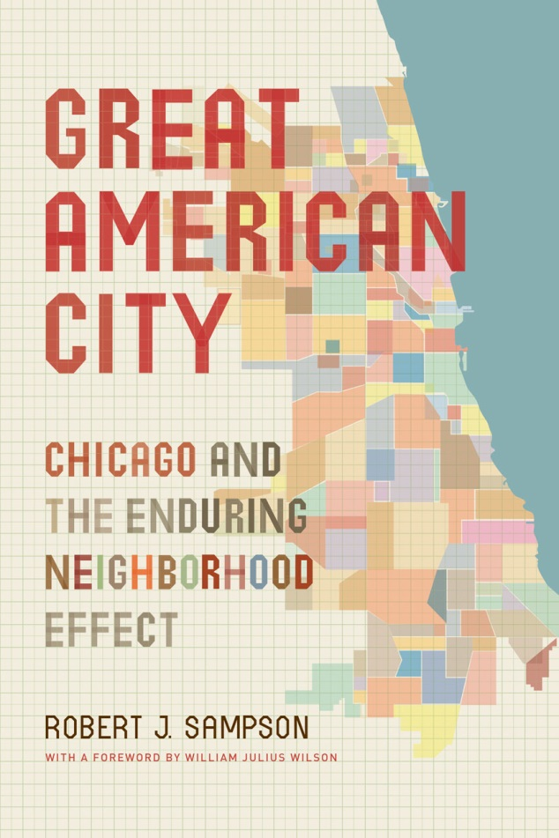
PHDCN Original Design*
Longitudinal study of 6,200 children
7 cohorts in 1995 (infant, 3, 6, 9, 12, 15, 18)
Probability Samples from 80 neighborhoods
Stratified by race and social class
Three waves, 1995-2002
Parents/caretaker and child assessments
75-78% response rates
Includes longitudinal study of 343 neighborhoods
* Major funders: John D. and Catherine T. MacArthur Foundation and National Institute of Justice

Slide 6
Wave 4 — 2011-2012
N=1,057, nationwide field effort (funded by MacArthur Foundation)
Random sample of original infant, 9, 12, and 15 year-old cohorts
63% response rate overall at wave 4
Analysis weights constructed to reflect attrition bias
Diverse sample: 40% Latino, 37% Black, and 19% White

Slide 7


Wave 5— May to October, 2021
Multi-mode survey: web, phone, F2F (N = 682)
66% response rate
Analysis weights constructed to reflect attrition bias
Official criminal justice histories, 1995-2020
Planned through 2023

Slide 8
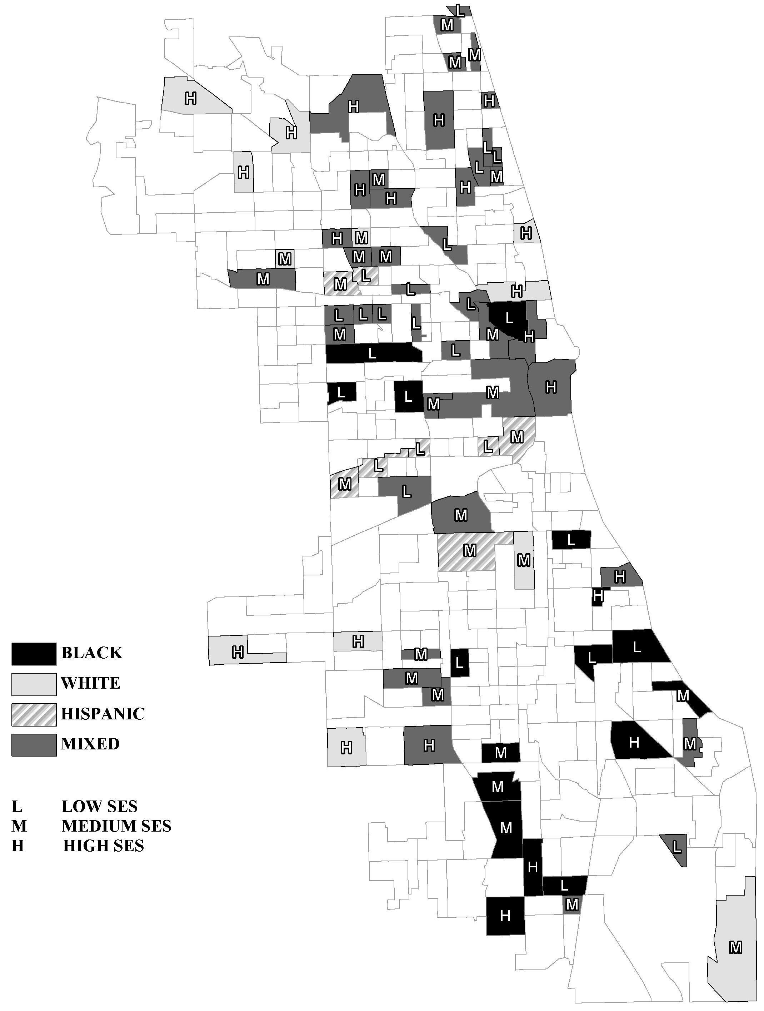
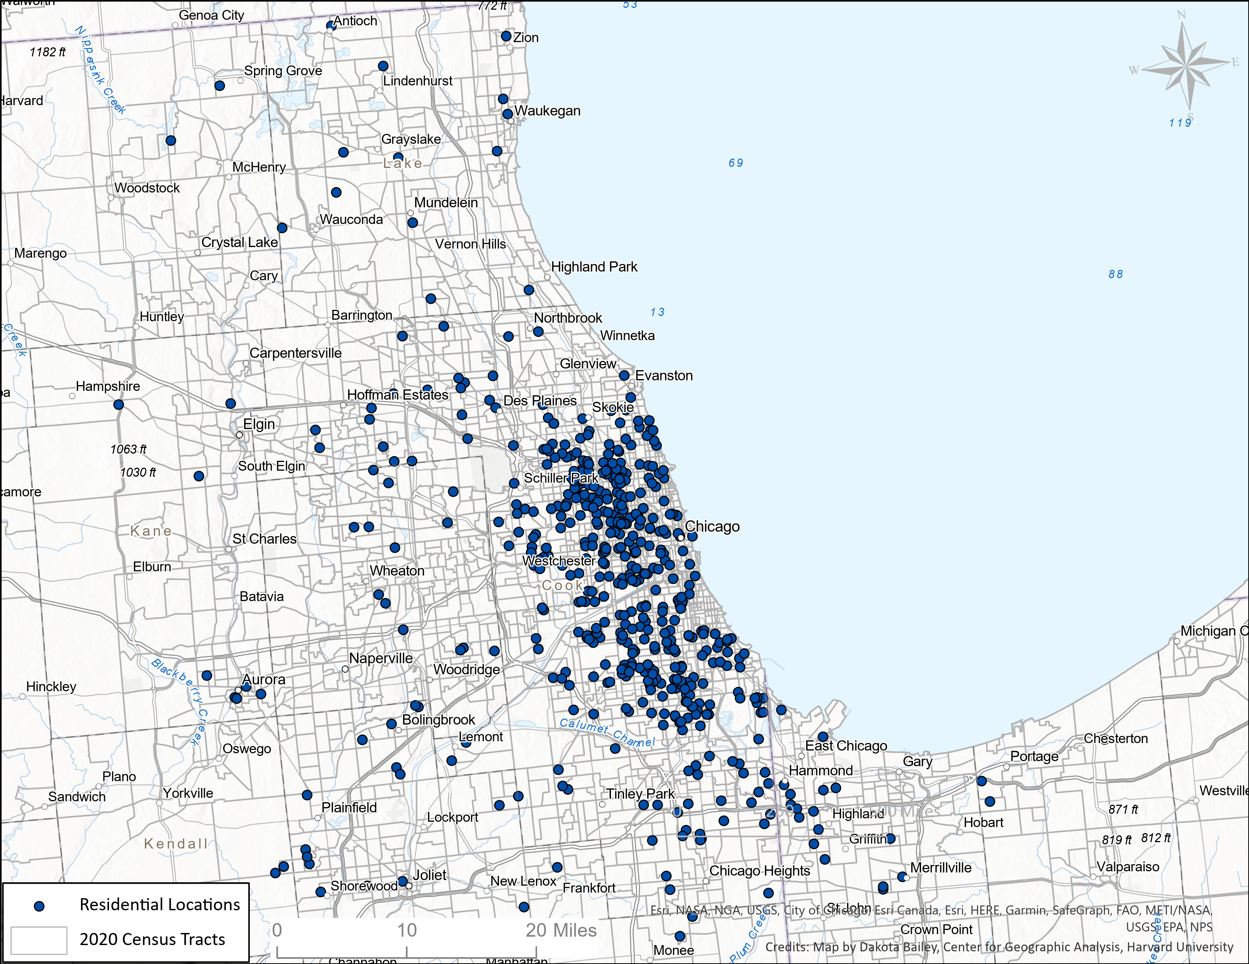
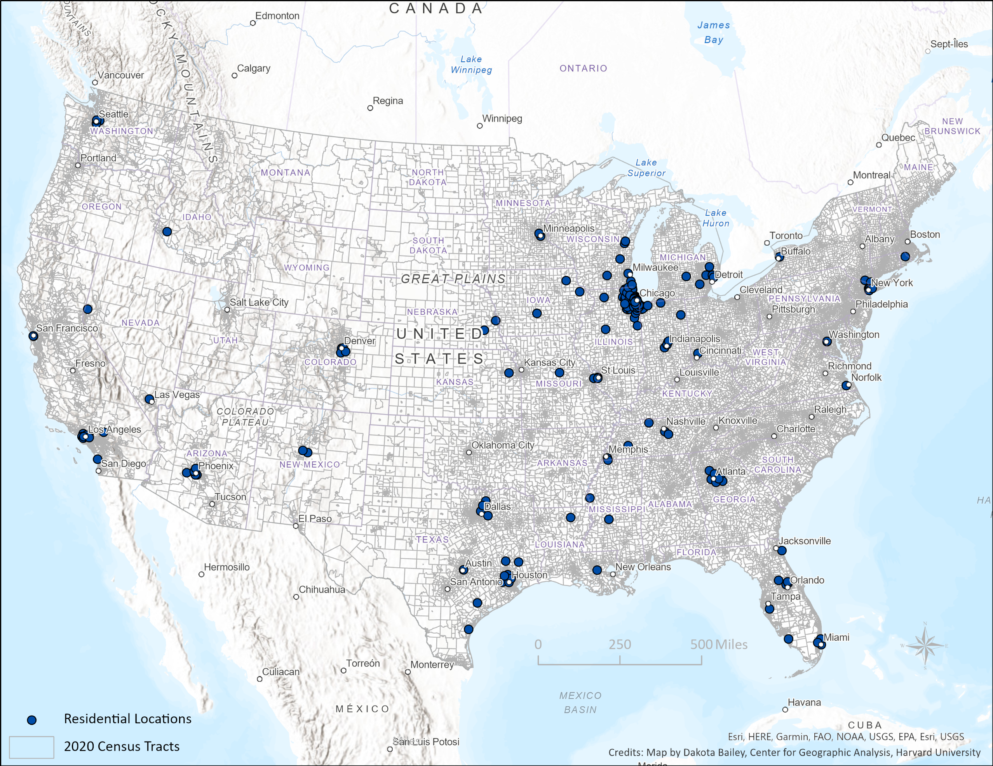
1995
Where are they as of 2021?

Slide 9

Resulting Sequential Birth-Cohort Design: Children’s Life Course in a Changing Crime,
Criminal Justice, and Inequality Landscape over the Last Quarter Century
“Urban High-Crime Era/ Peak of Start of High Incarceration, Aggressive Pandemic/
Crisis” Rise in Incarceration Violence Crime Decline Policing, Lower Crime Increasing crime
1975 1980 1985 1990 1995 2000 2005 2010 2020 Wave 5
PHDCN+ Study Period
Infant Cohort: 0 5 10 15 25
Early Childhood to Transition to
Childhood Adolescence Adulthood
*******************************************************************************************************
Adolescent Cohorts:
9 year 0 4 9 14 19 24 34
12 year 0 2 7 12 17 22 27 37
15 year 0 5 10 15 20 25 30 40
Early Childhood Transition to Young-Mid
Childhood to Adolescence Adulthood Adulthood

Slide 10
Neighborhood Conditions over Time

Slide 11
Continuity and Change in Exposure to Violence by Cohort

Slide 13
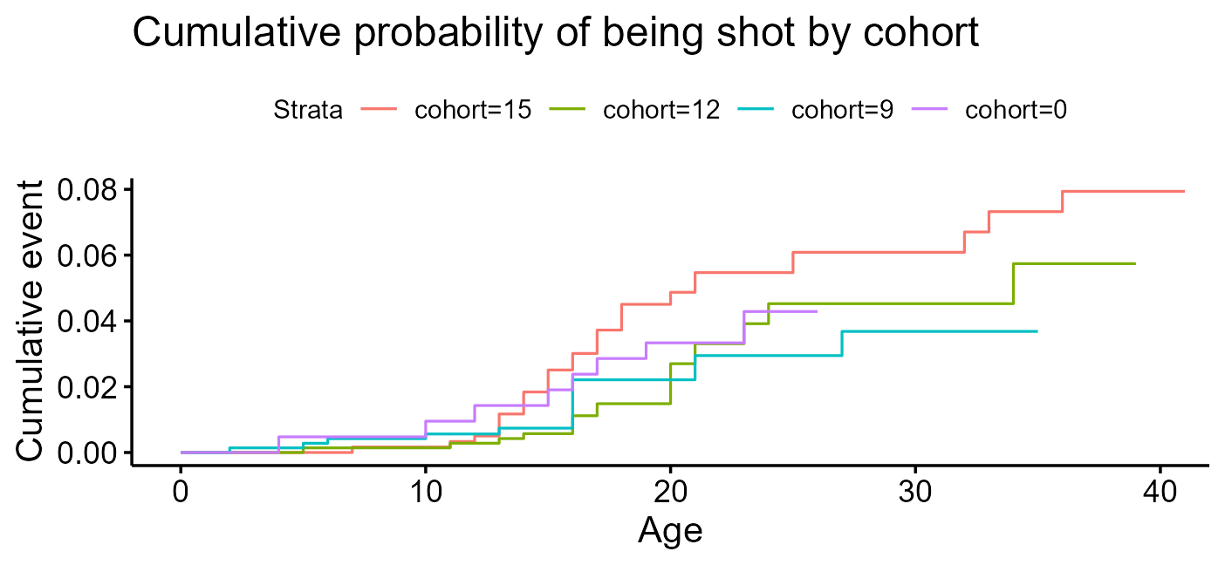
Kaplan-Meier Survival Models of ETV
Notes:
DV: time until event (being shot)
In your whole life, have you ever been shot? How old were you when this first happened?
1- S(t)

Slide 14
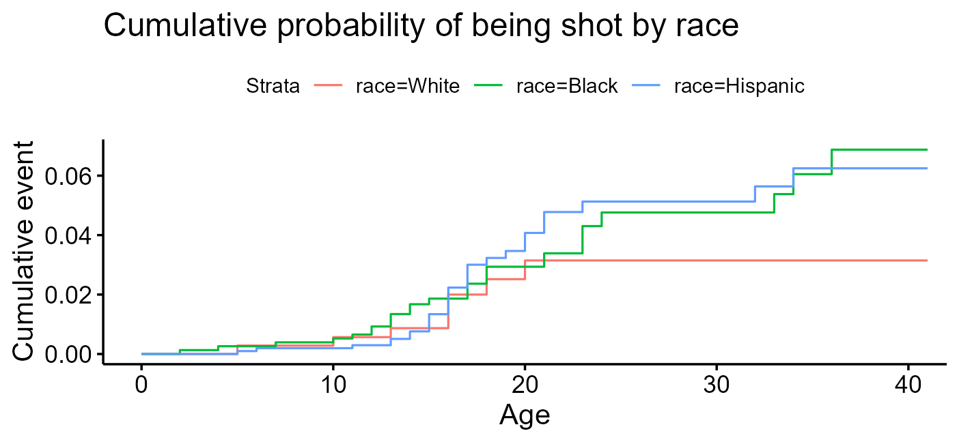

Slide 15
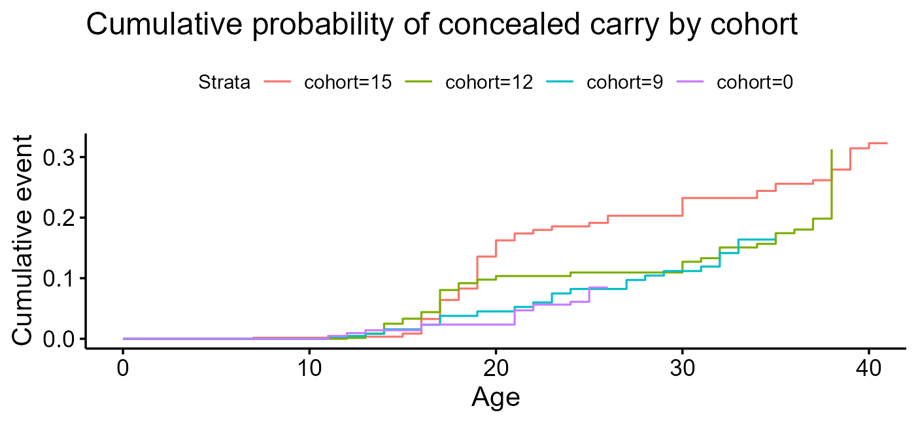
Notes:
Have you ever carried a concealed or hidden gun with you anywhere, whether you had a permit for the gun or not?
What age were you the first time you carried a concealed or hidden gun with you anywhere?

Slide 16
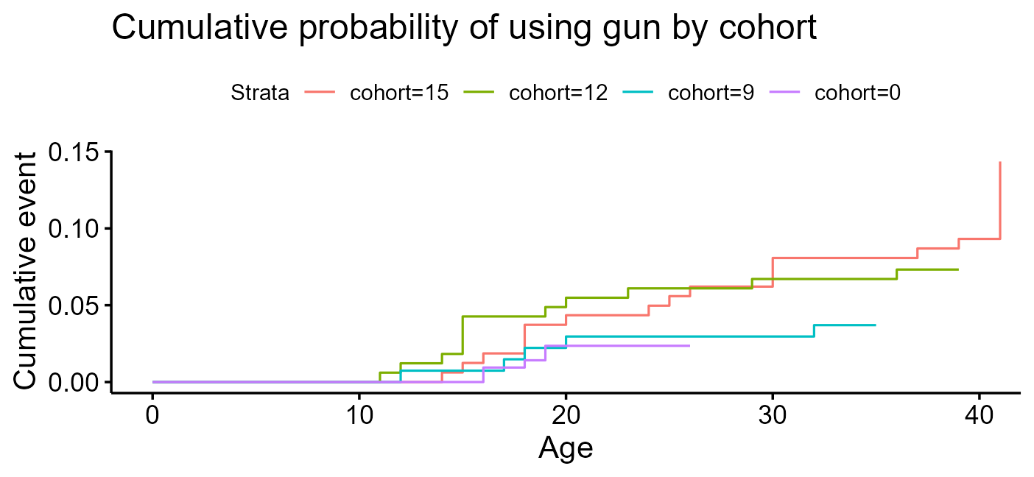
Notes:
Have you ever used a gun, even if it was not fired, to protect yourself, someone else, or your property? How old were you when this first happened?

Slide 17
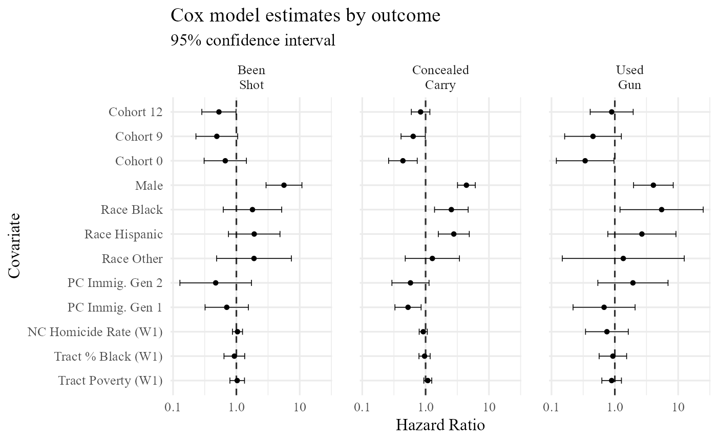
Notes:
Reference categories are: white, female, cohort 15, 3+ imm generation

Slide 18
Future Analysis Plans Include:
Period Effects / Social Change & ETV
Life Course of Victimization through Mid-Adulthood
Reproduction of Gun violence
Long-term Causal Consequences of ETV for Health and Well-being
The Extent and Consequences of Exposure to Police Brutality

Slide 19
Feedback and Questions?
Contact Info:
David Kirk
Department of Sociology & Nuffield College
University of Oxford
david.kirk@sociology.ox.ac.uk
https://sites.harvard.edu/phdcn/

Slide 20
Appendix

Slide 21
Major Survey Domains
Demographics, Family Relations
Education/Occupational History
Assets and Earnings
Neighborhood Context
Social Isolation/Support
Civic & Political Engagement
Residential History
Gun Carrying and Use
Gun Victimization and Exposure
Criminal Involvement
Fear and Safety Perceptions
Views of the Law & Police
Contact with Police/Police Brutality
Life Events (e.g., Prison Experiences)

Slide 22
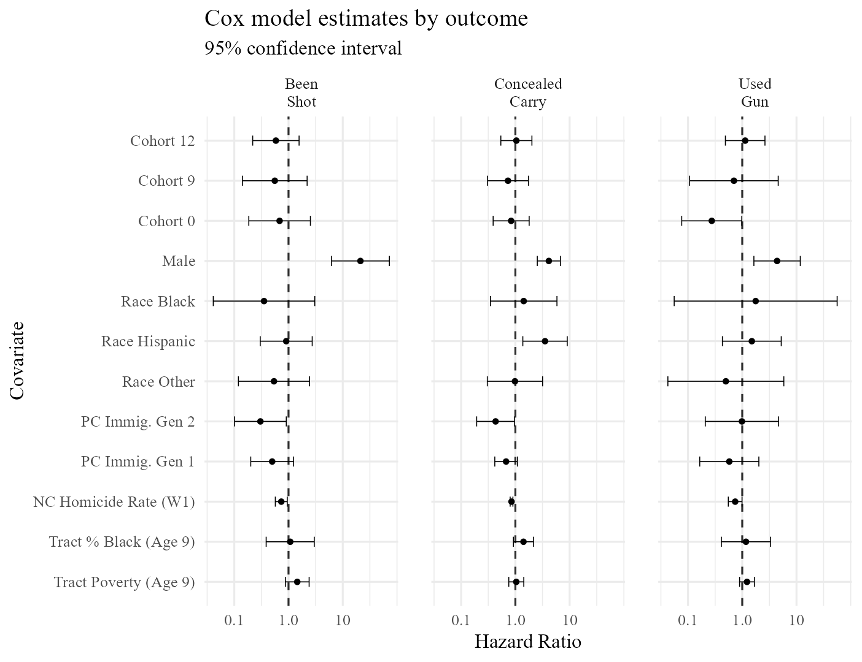
Wave 5 Sample, Unweighted

Slide 23
Wave 5 Sample, Weighted

Slide 24
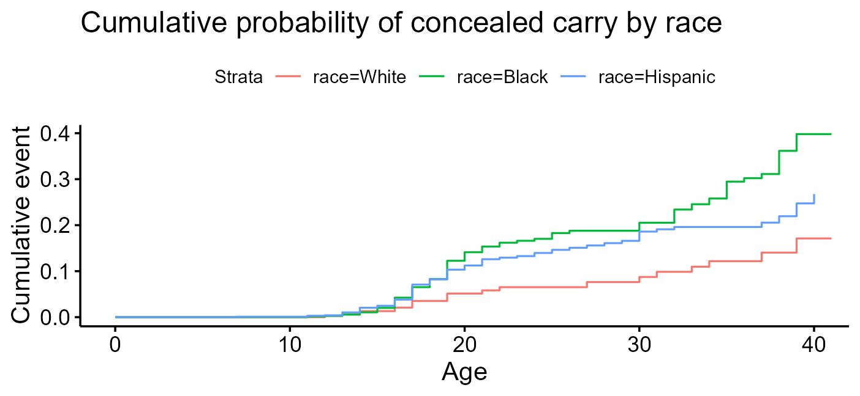

Slide 25
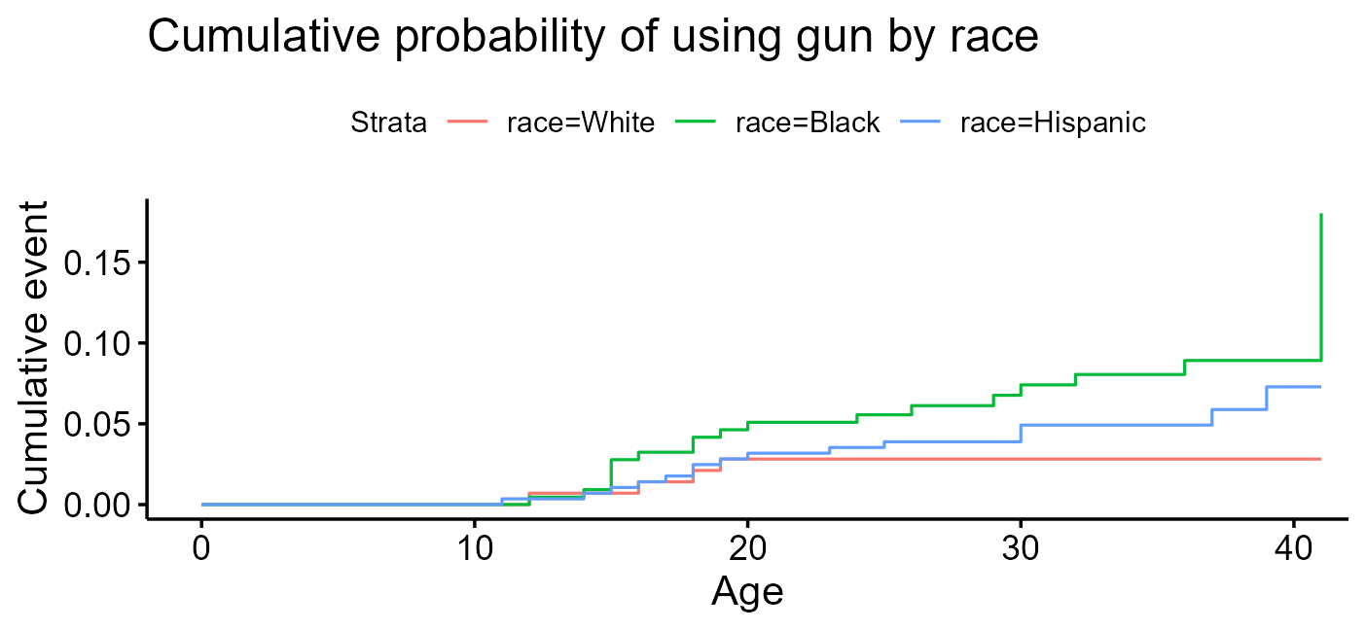

Slide 26
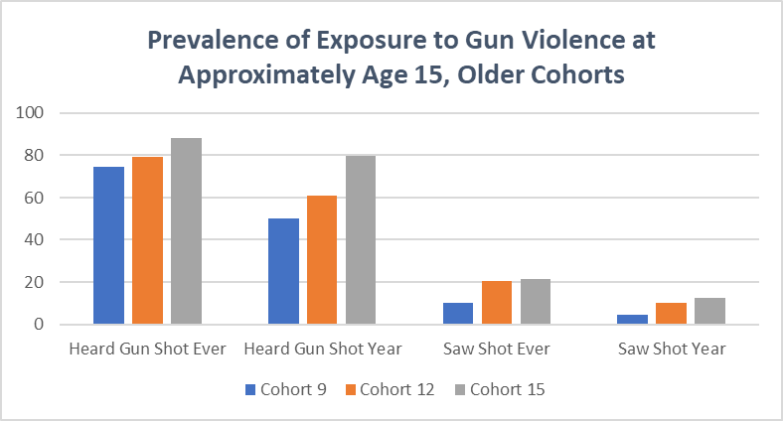

Slide 27
Advantages of PHDCN+
Representative population sample
vs. conditioned on CJS contact (e.g., court samples, police encounters)
Rich measurement across multiple domains (child, caretaker)
Linked with official records of criminal history, over 28 years
Intergenerational criminality among children of the prison boom
Contextual, multi-level design
With independent neighborhood-level measures
Long-term follow-up in important historical era
Sequential cohort design, starting at birth, ages 0 to 41

Slide 28
All Survey Domains
Demographics
Neighborhood Issues
Social Isolation/Support
Civic & Political Engagement
Residential History
Personal Victimization, Fear & Gun Violence
Crime, Gun Carrying & Use
Views of the Law & Police / Contact with Police
Family & Household Roster
Housing History
Life Events (e.g., Jail/Prison Experience)
Education
Occupational History
Assets & Earnings

Slide 29
Criminal Justice Histories
Illinois “Criminal History Record Information” (CHRI)
Represents all jurisdictions in Illinois (~1,200) but the vast majority of sample (~88%) stayed in the greater Chicago area
Records by date on all arrests, charges, and sentences, 1995-2020
Probabilistic matching to PHDCN Wave 4 sample; >80% of matches yielded a probability of 100% accuracy, and >90% were ≥99%
Search through 2020 yielded records on ~380 of 1,057 cohort participants (36%), ~1,500 unique arrests, and over 2,300 charges

Slide 30
Attrition Predictors
Male
Black
Cohort
Outside of Chicago MSA
Bachelor’s +
Income > $60,000
Prior Arrest (17-24)

Slide 31
PHDCN+ - “Wave 5”
Multi-Mode Survey
CATI (23.61%)
CAWI (71.41%)
FTF (4.99%)
Conducted May 2021-October 2021
Focal Domains
Gun victimization and exposure
Gun possession/ownership/carrying
Gun use
Fear, perceptions of safety
Criminal offending
Criminal justice contact
Note: these are provisional estimates before end of data collection and final determination of eligibility status.

Slide 32
Summary & Future Analysis Plans Include:
Period Effects / Social Change & ETV
Life Course of Victimization through Mid-Adulthood
Reproduction of Gun violence
Long-term Consequence of ETV for Health and Well-being
The Extent and Consequences of Exposure to Police Brutality
Intergenerational Transmission of CJ Contact

Slide 33
Continuity and Change in Exposure to Gun Violence
Notes:
Of the (682) participants at W5, 39% (N=266) resided in the same nhood (census tract) as a GUN homicide in 1995 (49% in tract with any homicide). [for full sample of 6,207, it was 49% gun and 59% all homicides]. Similarly in 2021, now as adults, 35% resided in a nhood that had a gun homicide.

Slide 34
More Change in Exposure to Violence

